Slide 1
A Pedagogical Approach to Create and Assess Domain Specific Data Science Learning Materials in the Biomedical Sciences
Preliminary Exam for Daniel Chen
February 19, 2021

Slide 2
Goal: Create and assess a data science curriculum
Domain specific: biomedical sciences
Who are our learners
Are the learning materials effective
Tie in computer science pedagogy

Slide 3
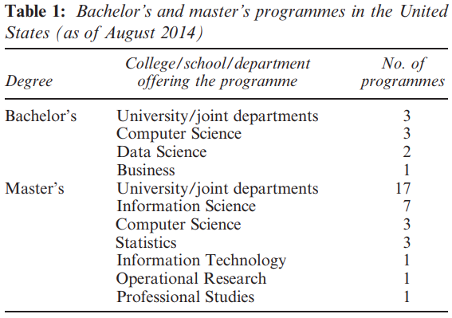
Current status of data science education
Joint departments
(Song and Zhu, 2016)

Slide 4
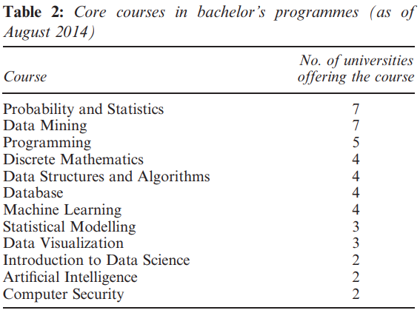
Current status of data science education
Joint departments
Probability + Statistics
Data Mining
Programming
(Song and Zhu, 2016)

Slide 5
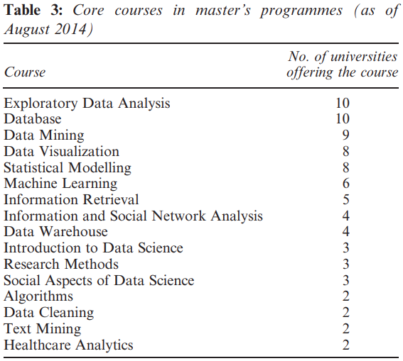
Current status of data science education
Joint departments
Probability + Statistics
Data Mining
Programming
Exploratory Data Analysis
Database
Data Mining
(Song and Zhu, 2016)

Slide 6
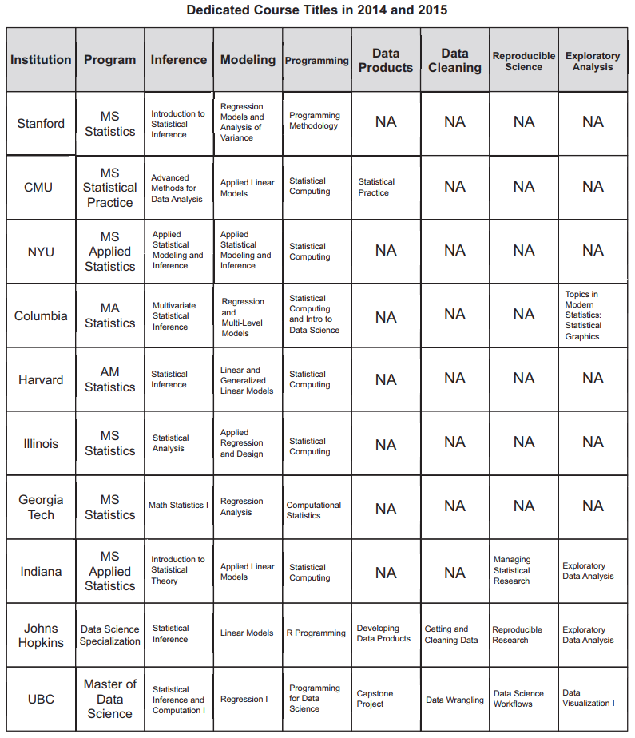
Most people are
missing “data” classes
As data science education becomes a commodity
Content is not an issue
Learning platforms
Domain experts to help navigate learners improve data literacy
Changing open source landscape
(Kross et al., 2020)

Slide 7
Data science programs are too general
Data science programs target single broad audiences
Opportunity to branch out to different disciplines
Democratization of data science education enables more domain specific learning materials
(Kross et al., 2020)

Slide 8
Why Domain Specificity?
You learn better when things are more relevant
Internal factors for motivation
Create feedback loops
Self-directed learners
(Ambrose et al., 2010; Wilson, 2019)

Slide 9
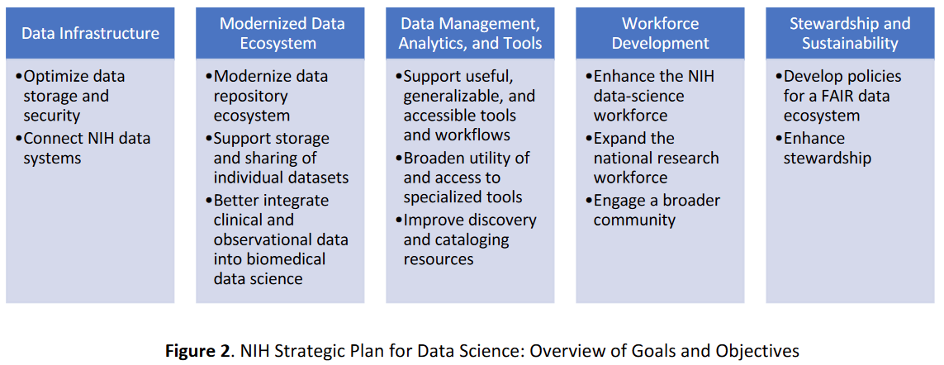
NIH Strategic Plan for Data Science
(National Institutes of Health, 2020)

Slide 10
NIH Biomedical Research
Support substantial quantities of biomedical data and metadata
Data is highly distributed
Accomplished by small groups of researchers
Variety of formats lead to complications in cleaning
Develop a research workforce
(National Institutes of Health, 2020)

Slide 11
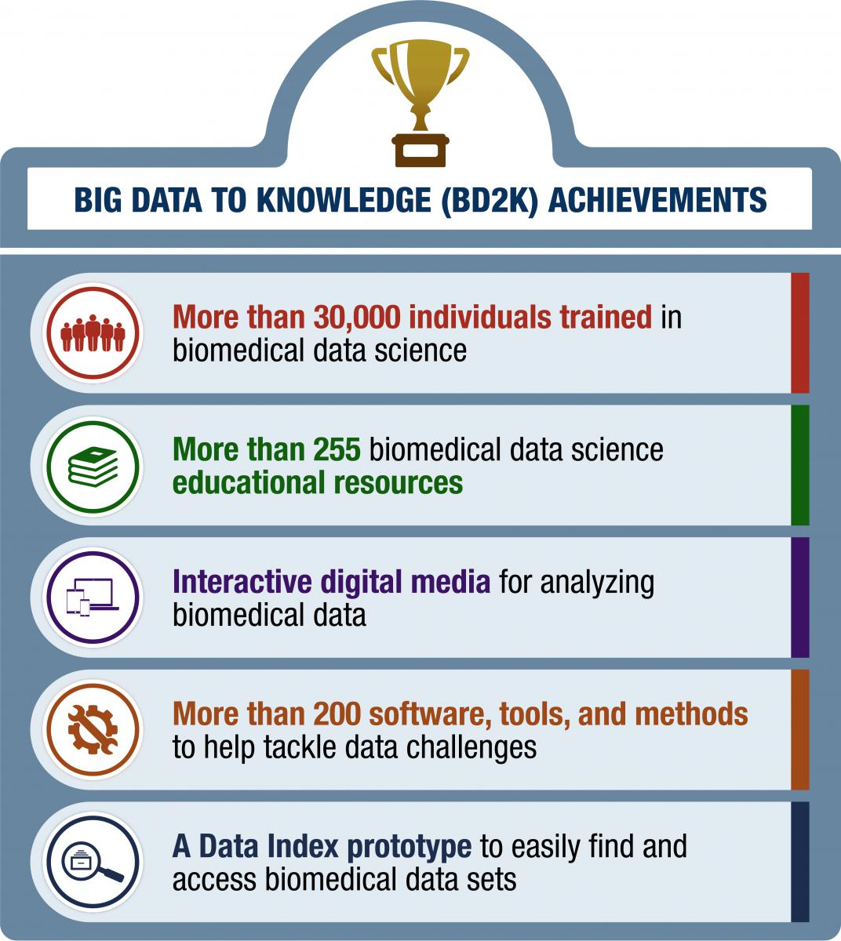
NIH The Big Data to Knowledge (BD2K)
2013 - 2018
Narrow the gap in biomedical data science skills
Train and educate workforce on analytical skills
Main issues
Not maintained
No programming component
Not focused around data literacy
(Dunn and Bourne, 2017; National Institutes of Health, 2013)

Slide 12
Computer Science Education
Adjacent to our goals
ACM / IEEE curriculum recommendations
Computer engineering
Computer Science
Information System
Information Technology and Software Engineering
Difference
“DataFrame” objects are not standard computer science data structures

Slide 13

Data Carpentry
"Fundamental data skills needed to conduct research..."
Core Curriculum Materials
Ecology curriculum
Genomics curriculum
Social Sciences curriculum
Geospatial data curriculum
Under development / consideration
Image Processing curriculum
Economics curriculum
Astronomy curriculum
Digital humanities curriculum
Other curricula
Community Developed Lessons
Carpentries Incubator
Carpentries Lab
Data Science For Practicing Clinicians
There still is a need:
Carpentries Instructor class at the Network of the National Library of Medicine (NNLM) March 2 - 5, 2021
Leverage the community to build a community to maintain

Slide 14
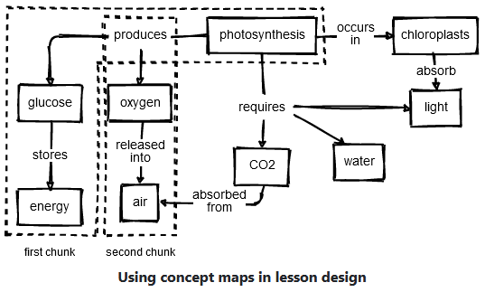
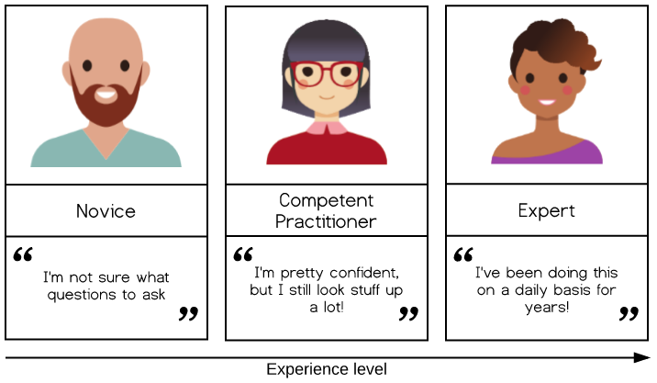
Who Are Our Learners?
AMA has a movement to change the medical curriculum (American Medical Association, 2021)
What do we know about their prior knowledge? (Ambrose et al., 2010; Koch and Wilson, 2016; Wilson, 2019)
Concept maps (Wilson, 2019)
Dreyfus model of skill acquisition (Koch and Wilson, 2016; Dreyfus and Dreyfus, 1980)

Slide 15

How to Identify Our Learners?
Assessment tools
Create learner personas

Slide 16
Are the Materials Effective?
Create the materials
Test retest design
Pre, post, and long-term survey
Workshop not classroom setting
Assessment needs to be more flexible
Questions need to be broken down for learners
Ask about confidence not objective assessment
(K. Jordan, 2016, 2018; K. Jordan et al., 2018; K. L. Jordan, Marwick, Duckles, et al., 2017; K. L. Jordan, Marwick, Weaver, et al., 2017; K. L. Jordan and Michonneau, 2020)

Slide 17
Tie in Computer Science Pedagogy
The topics and ordering are not the same
The teaching methodology applies
Backwards-design testing of assessment question types
Faded examples (will add Parson’s)
Prevents "empty page" syndrome
Formative assessment question types
Not summative assessment

Slide 18
Hypothesis & Specific Aims
Learning materials around tidy data principles will help learners incorporate programming and data science skills from their spreadsheet workflows.
NIH Data Management, Analytics, Tools + Workforce Development
Aim 1: Identify learner personas in the biomedical sciences by creating and validating learner self-assessment surveys.
Aim 2: Create an effective data science for biomedical science curriculum based on best education and pedagogy practices.
Aim 3: Assess the effectiveness of formative assessments in learning objectives.

Slide 19
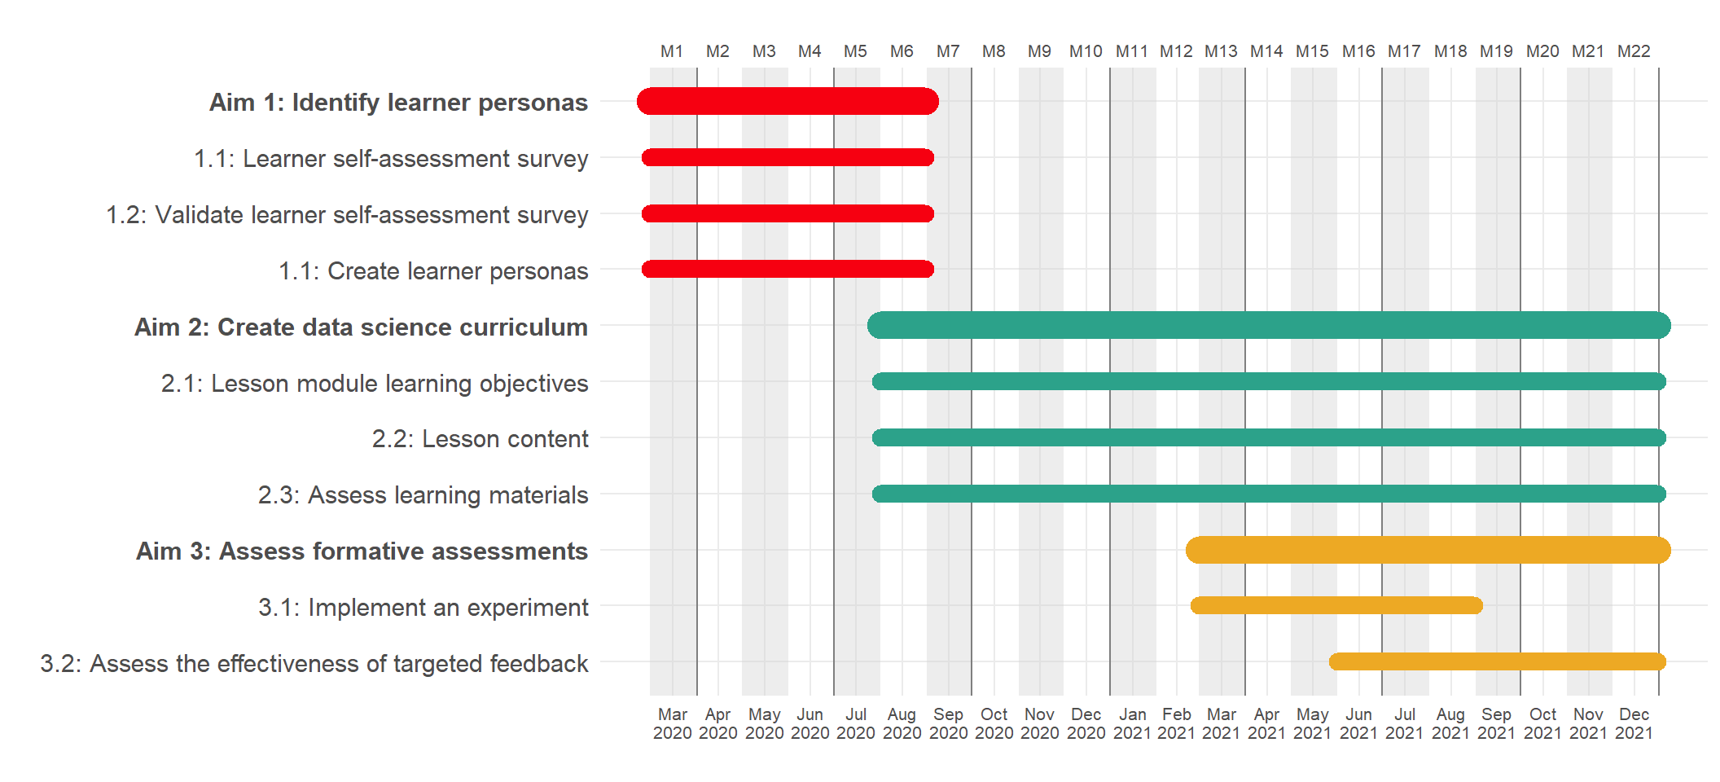
Timeline

Slide 20
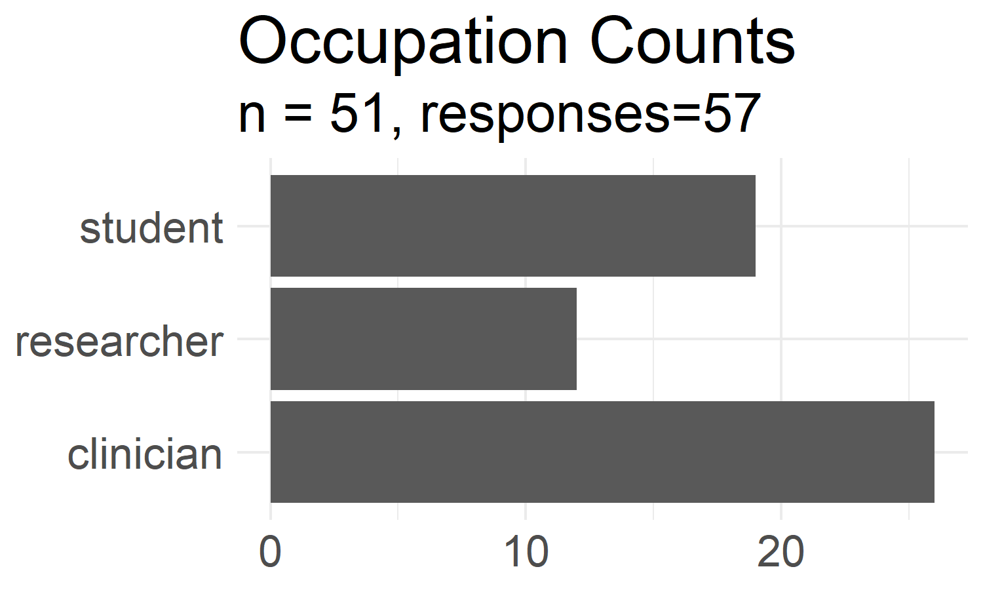
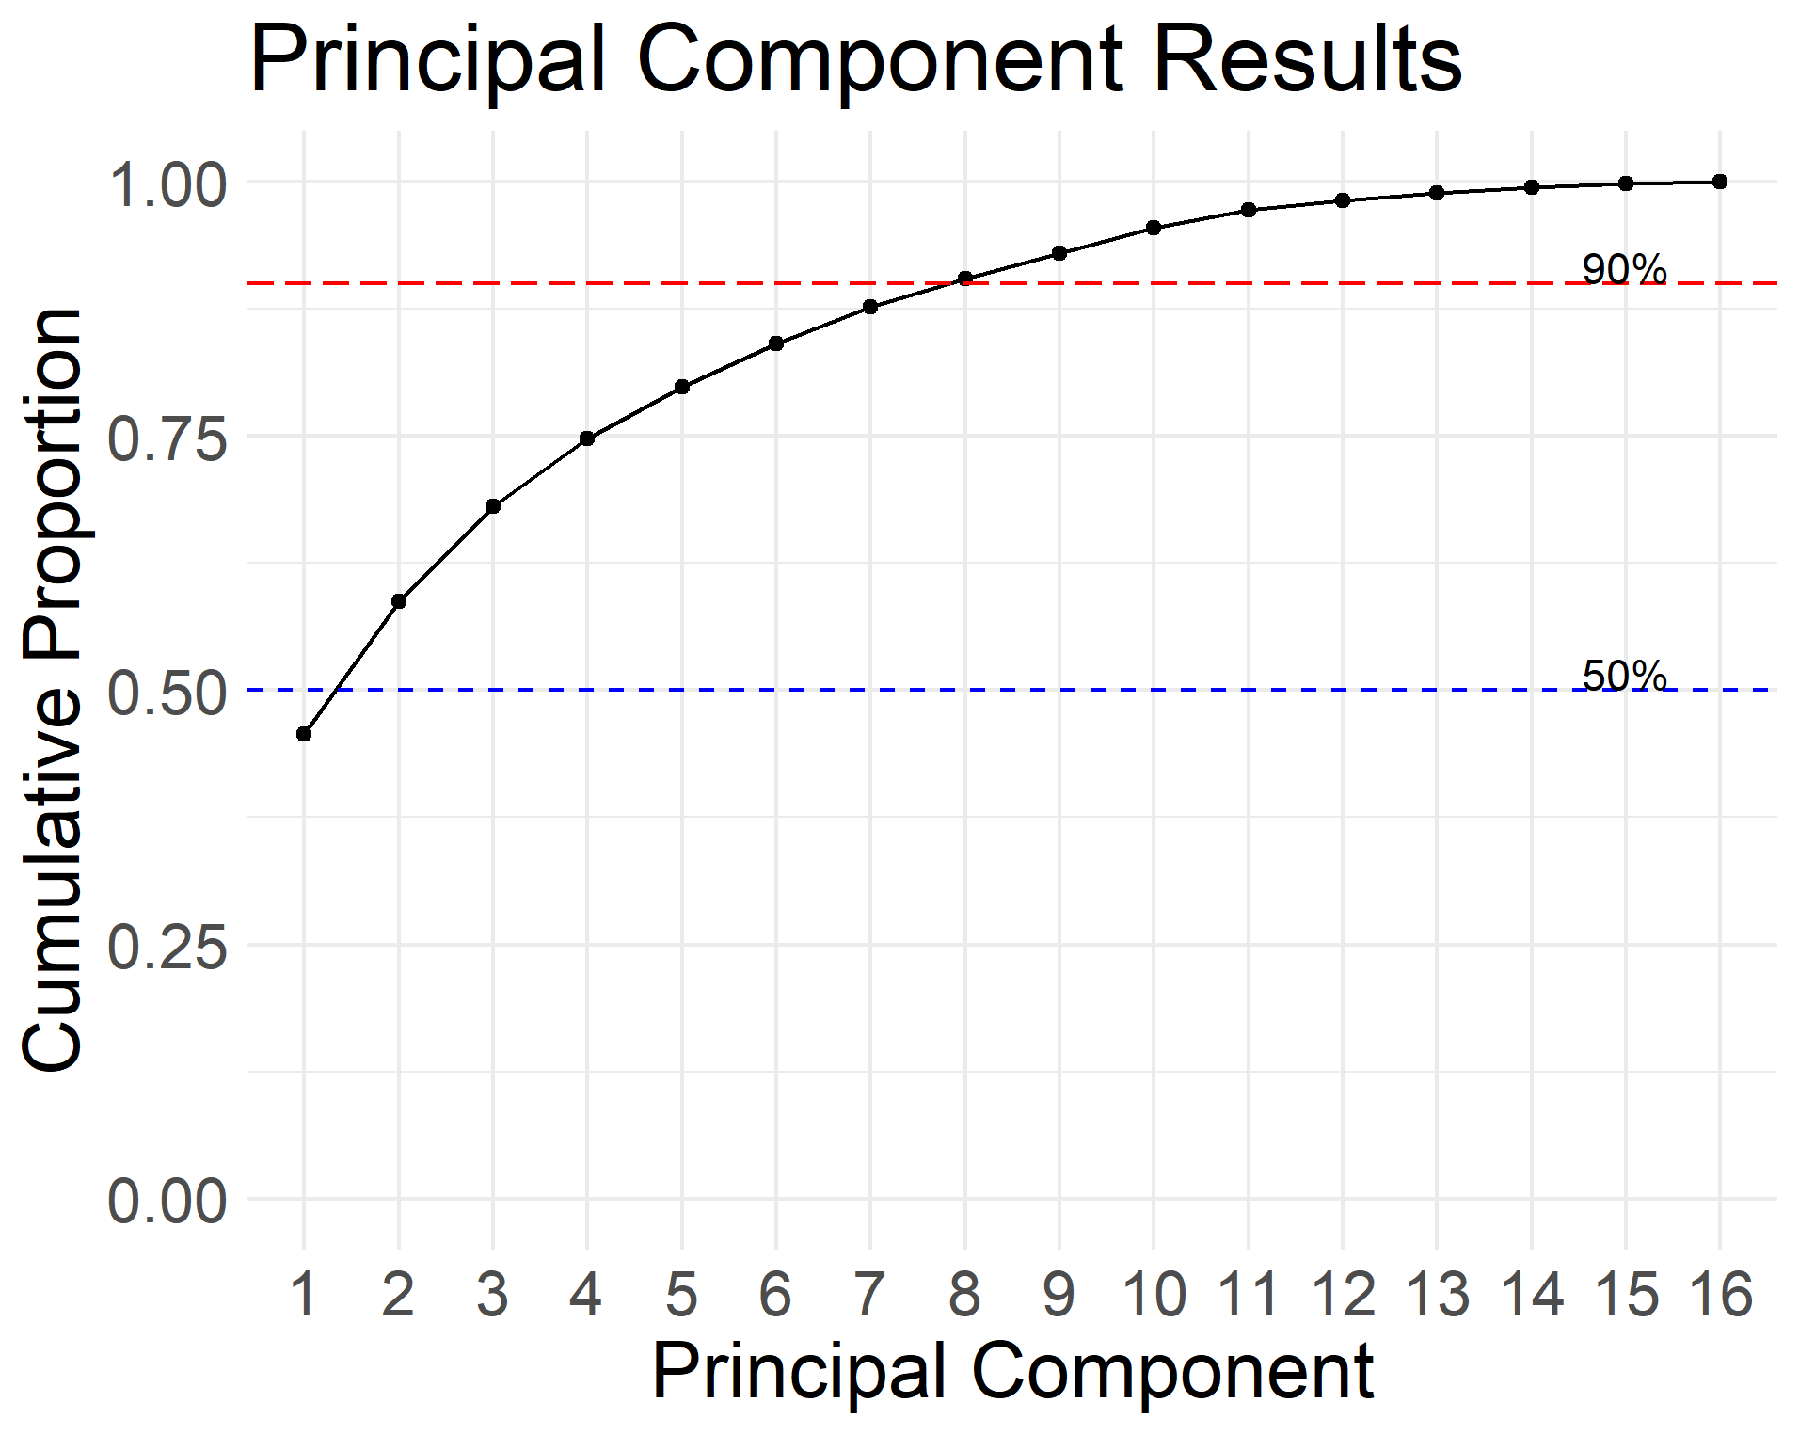
Aim 1: Identify Learner Personas
45 responses were used for the clustering due to missing responses
1. Alex Academic
2. Clare Clinician
3. Patricia Programmer
4. Samir Student

Slide 21

Aim 2: Create Data Science Curriculum
https://ds4biomed.tech/
Introduction
Spreadsheets
R + RStudio
Load Data
Descriptive Calculations
Clean Data (Tidy)
Visualization (Intro)
Analysis Intro (Logistic)

Slide 22
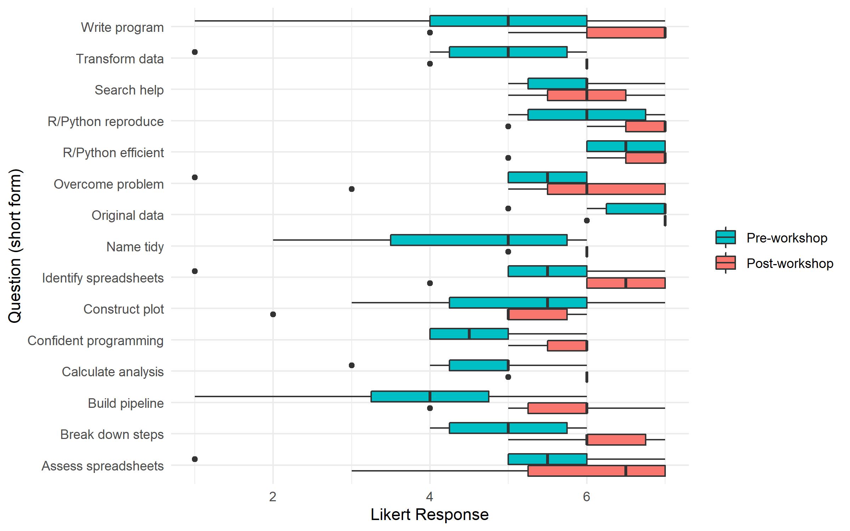
Pre-Post Workshop Changes
Most participants have more confidence in their programming and data abilities.
N = 10 (pre = 5; post = 5)

Slide 23
Wilcoxon Rank Sum Test
Non-parametric alternative to paired t-test
We can conclude that the median confidence of tasks before the workshop is significantly different from the median confidence of tasks after the workshop
Two-sided
Unpaired
Short question V p.value
1 Original data 0 0.000102
2 Write program 2.5 0.000252
3 Search help 0 0.000130
4 Overcome problem 2.5 0.000271
5 Confident programming 0 0.000114
6 R/Python reproduce 0 0.000116
7 R/Python efficient 0 0.0000998
8 Name tidy 0 0.000116
9 Transform data 2.5 0.000232
10 Identify spreadsheets 2.5 0.000263
11 Assess spreadsheets 2.5 0.000266
12 Break down steps 0 0.000133
13 Construct plot 0 0.000133
14 Build pipeline 2.5 0.000268
15 Calculate analysis 0 0.000125
N = 10 (pre = 5; post = 5)
Dropped 1 observation that was paired

Slide 24
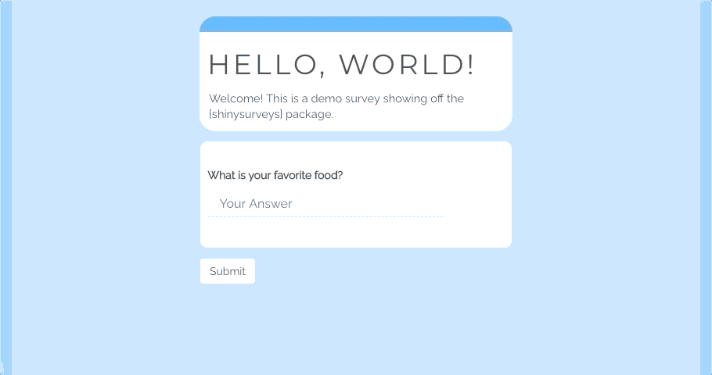
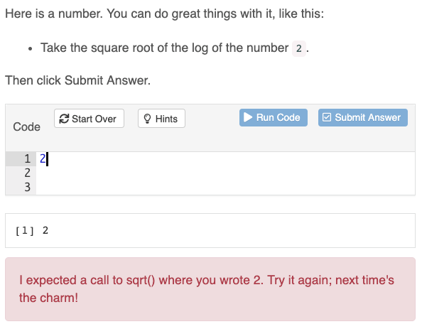
Aim 3: Assess Formative Assessments
{shinysurveys}, {gradethis}, Data Science in a Box

Slide 25
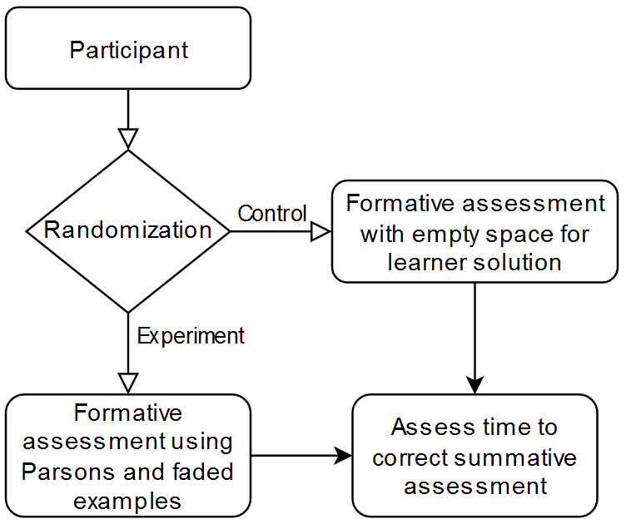
Aim 3 Study Design
Need a new IRB
Can use the students from BEL lab
Survey bias, but faster response rates
2 Groups, Continuous (time) + Binary (correct) measurements
t-test, ANOVA

Slide 26
In conclusion...
Identified and created learner personas and assessment survey (Aim 1)
Working on building out more content (Aim 2)
OMOP and HL7 FHIR data format examples
Next steps:
Build the experimental assessment platform (Aim 3)
Paper #1: Creation of personas a validated survey
More workshops + expand content

Slide 27
Questions?

Slide 28
References
Ambrose, S. A., Bridges, M. W., DiPietro, M., Lovett, M. C., and Norman, M. K. (2010). How learning works: Seven research-based principles for smart teaching. John Wiley & Sons.
American Medical Association. (2021). Accelerating Change in Medical Education. American Medical Association. https://www.ama-assn.org/education/accelerating-change-medical-education
Anderson, L. W., Bloom, B. S., and others. (2001). A taxonomy for learning, teaching, and assessing: A revision of Bloom’s taxonomy of educational objectives. Longman,.
Castro-Schilo, L. (2017, April 25). Principal components or factor analysis? JMP User Community. https://community.jmp.com/t5/JMP-Blog/Principal-components-or-factor-analysis/ba-p/38347
Chen, D. (2017). Pandas for Everyone: Python Data Analysis (1st edition). Addison-Wesley Professional.
Dreyfus, S. E., and Dreyfus, H. L. (1980). A five-stage model of the mental activities involved in directed skill acquisition. California Univ Berkeley Operations Research Center.
Dunn, M. C., and Bourne, P. E. (2017). Building the biomedical data science workforce. PLoS Biology, 15(7), 1–9. http://login.ezproxy.lib.vt.edu/login?url=http://search.ebscohost.com/login.aspx?direct=true&db=a9h&AN=124144283&scope=site
Feldon, D. F., Jeong, S., Peugh, J., Roksa, J., Maahs-Fladung, C., Shenoy, A., and Oliva, M. (2017). Null effects of boot camps and short-format training for PhD students in life sciences. Proceedings of the National Academy of Sciences of the United States of America, 114(37), 9854–9858. https://doi.org/10.1073/pnas.1705783114
Gans, M., Tody, H., and Greg, W. (2020). JavaScript for Data Science. https://js4ds.org/
Harrison, M. (2016). Learning the Pandas Library: Python Tools for Data Munging, Analysis, and Visual (9781533598240): Harrison, Matt, Prentiss, Michael: Books. https://smile.amazon.com/Learning-Pandas-Library-Munging-Analysis/dp/153359824X/ref=sr_1_1?dchild=1&keywords=Learning+the+Pandas+Library&qid=1613551948&sr=8-1
Jordan, K. (2016). Data Carpentry Assessment Report: Analysis of Post-Workshop Survey Results. Zenodo. https://doi.org/10.5281/zenodo.165858
Jordan, K. (2018). Analysis of The Carpentries Long-Term Impact Survey. Zenodo. https://doi.org/10.5281/zenodo.1402200
Jordan, K. L., Marwick, B., Duckles, J., Zimmerman, N., and Becker, E. (2017). Analysis of Software Carpentry’s Post-Workshop Surveys. Zenodo. https://doi.org/10.5281/zenodo.1043533
Jordan, K. L., Marwick, B., Weaver, B., Zimmerman, N., Williams, J., Teal, T., Becker, E., Duckles, J., Duckles, B., and Wickes, E. (2017). Analysis of the Carpentries’ Long-Term Feedback Survey. Zenodo. https://doi.org/10.5281/zenodo.1039944
Jordan, K. L., and Michonneau, F. (2020). Analysis of The Carpentries Long-Term Surveys (April 2020). Zenodo. https://doi.org/10.5281/zenodo.3728205
Jordan, K., Michonneau, F., and Weaver, B. (2018). Analysis of Software and Data Carpentry’s Pre- and Post-Workshop Surveys. Zenodo. https://doi.org/10.5281/zenodo.1325464

Slide 29
References
Koch, C., and Wilson, G. (2016). Software carpentry: Instructor Training. https://doi.org/10.5281/zenodo.57571
Kross, S., Peng, R. D., Caffo, B. S., Gooding, I., and Leek, J. T. (2020). The Democratization of Data Science Education. The American Statistician, 74(1), 1–7. https://doi.org/10.1080/00031305.2019.1668849
Lee, G., Bacon, S., Bush, I., Fortunato, L., Gavaghan, D., Lestang, T., Morton, C., Robinson, M., Rocca-Serra, P., Sansone, S.-A., and Webb, H. (2021). Barely sufficient practices in scientific computing. Patterns, 2(2). https://doi.org/10.1016/j.patter.2021.100206
McKinney. (2017). Python for Data Analysis (2nd ed.). https://www.oreilly.com/library/view/python-for-data/9781449323592/
National Institutes of Health. (2013, June 15). Big Data to Knowledge. https://commonfund.nih.gov/bd2k
National Institutes of Health. (2020, September 14). NIH Strategic Plan for Data Science | Data Science at NIH. https://datascience.nih.gov/nih-strategic-plan-data-science
Song, I.-Y., and Zhu, Y. (2016). Big data and data science: What should we teach? Expert Systems, 33(4), 364–373. https://doi.org/10.1111/exsy.12130
UCLA: Statistical Consulting Group. (2021, February 17). A Practical Introduction to Factor Analysis. https://stats.idre.ucla.edu/spss/seminars/introduction-to-factor-analysis/
Wickham, H., and Garrett, G. (2017). R for Data Science. https://r4ds.had.co.nz/
Wilson, G. (2019). Teaching tech together: How to make your lessons work and build a teaching community around them. CRC Press.
Wilson, G., Aruliah, D. A., Brown, C. T., Hong, N. P. C., Davis, M., Guy, R. T., Haddock, S. H., Huff, K. D., Mitchell, I. M., Plumbley, M. D., and others. (2014). Best practices for scientific computing. PLoS Biology, 12(1), e1001745.
Wilson, G., Bryan, J., Cranston, K., Kitzes, J., Nederbragt, L., and Teal, T. K. (2017). Good enough practices in scientific computing. PLoS Computational Biology, 13(6), e1005510.
Word, K. R. (2017, December 11). When Do Workshops Work? A Response to the “Null Effects” paper from Feldon et al. Software Carpentry. http://software-carpentry.org//blog/2017/12/response-null-effects.html

Slide 31
Response Rates
Self-assessment (persona): 51 respondents, 45 non-missing
3 Workshops:
 | Registrants | Attendees Day 1 | Attendees Day 2 | Pre workshop | Post workshop | Long-term
1 | 27 | 20 | 11 | 7 | 7 | N/A
2 | 5 (?) | 5 | N/A | 0 | 0 | N/A
3 | 45 | 19 | 16 | 12 | 7 | N/A
Total | 77 | 44 | 27 | 19 | 14 | ~ 0.5
% |  | -43% Registrants | -37% Day 1 | -57% Day 1 -75% Registrants | -26% Pre -68% Day 1 -82% Registrants | -98% Post

Slide 32
Survey Response Rates
Carpentries
 | Pre workshop | Post workshop | Long-term
dc | 1,259 | 862
swc | 14,154 | 6,458
Total | 15,413 | 7320 | 162

Slide 33
Listservs
iTHRIV (Taryn Luoma, MHA)
GBCB
IGEP (Dennie Munson)
VetMed (Andrea Green)
VT Carpentries workshops (Nathaniel Porter, PhD)
VT Roanoke Center (David Conners)
No explicit email sent to the for VCOM listserve
Sample population does not contain 8 iTHRIV Scholars

Slide 34
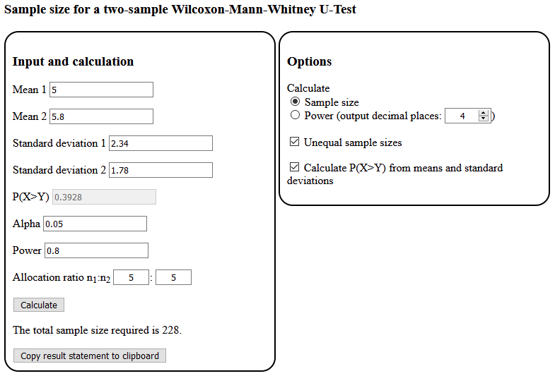
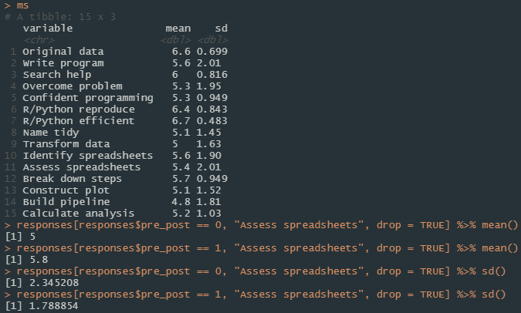
Power Calculation
https://homepage.univie.ac.at/robin.ristl/samplesize.php?test=wilcoxon

Slide 35
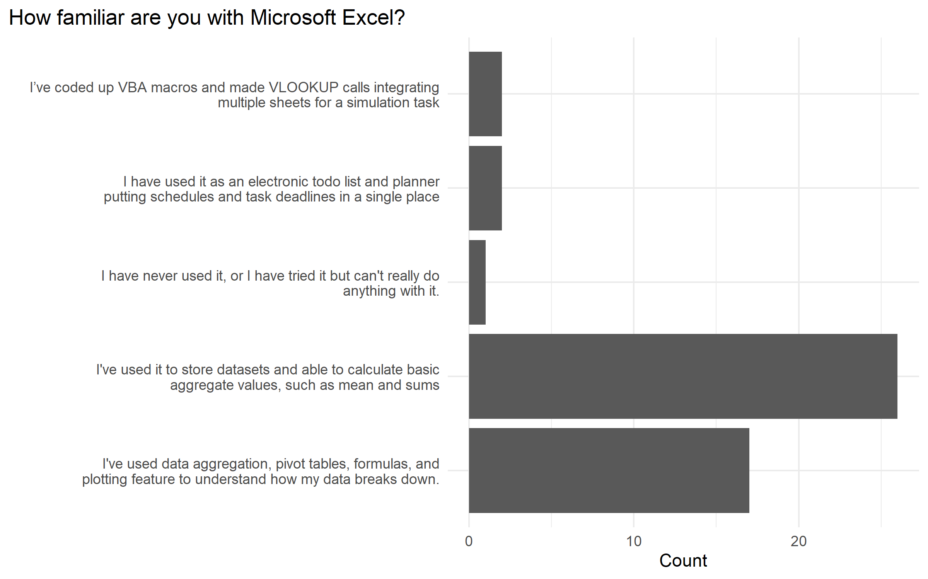
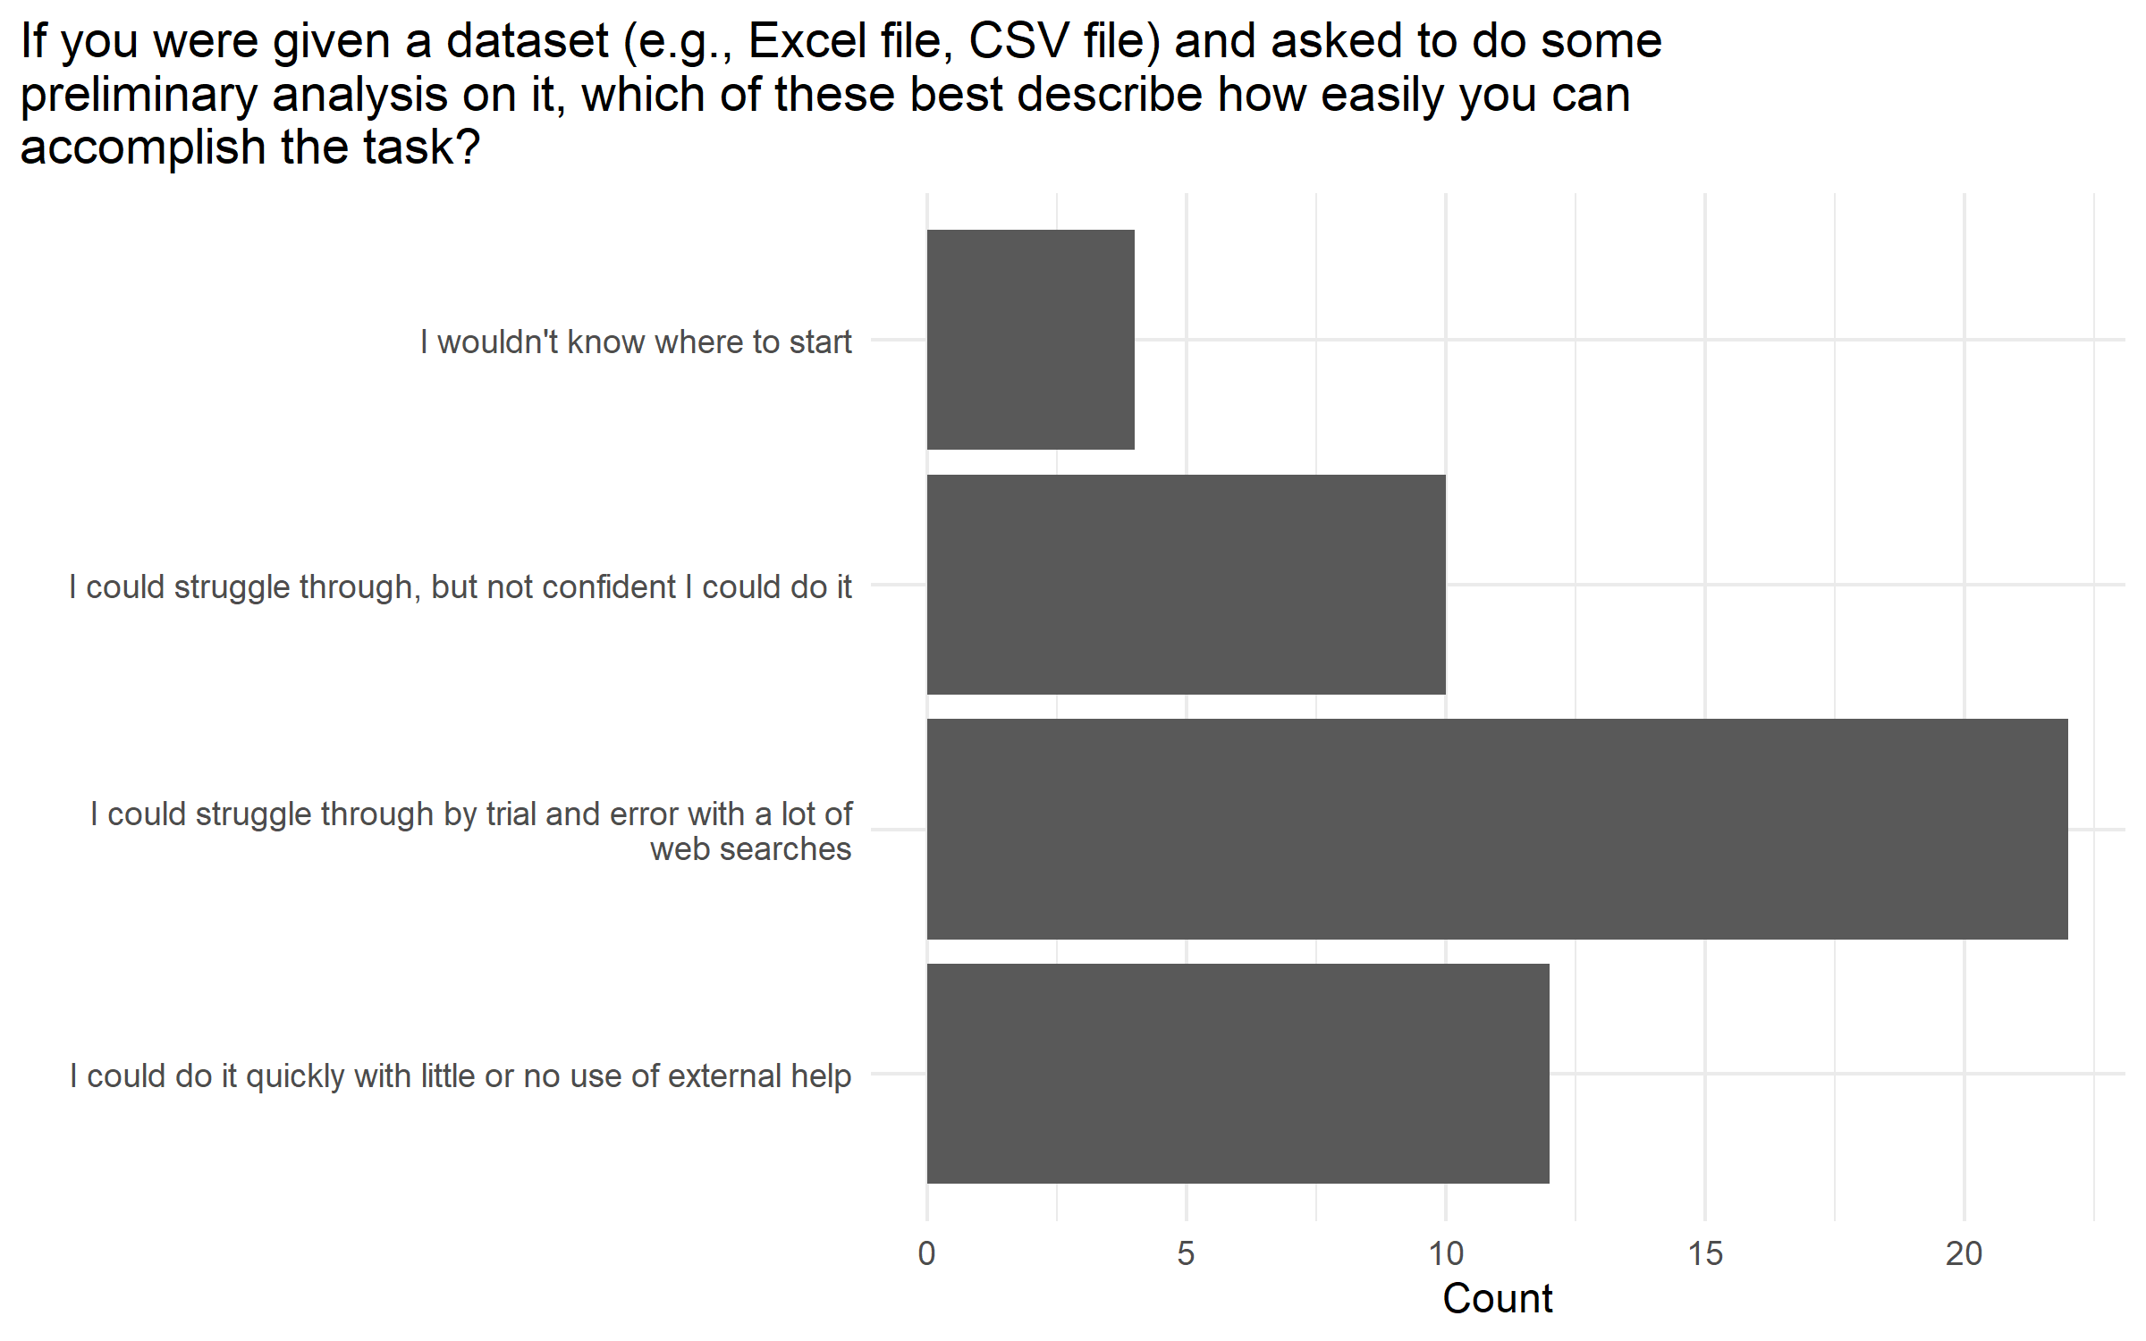
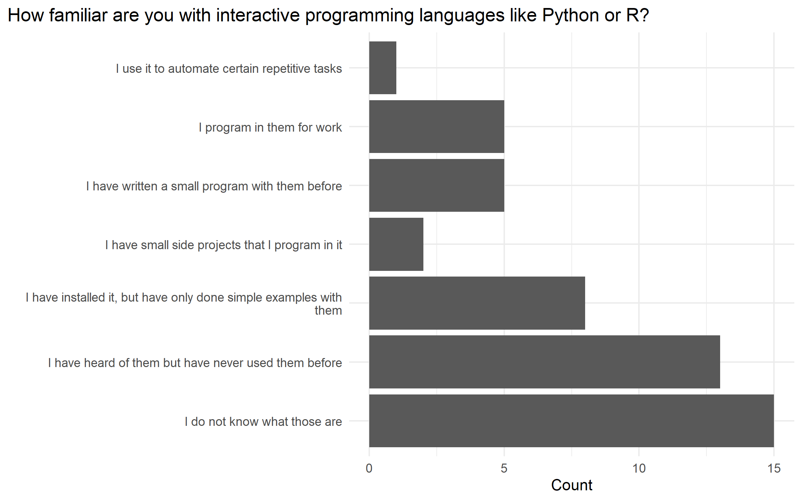
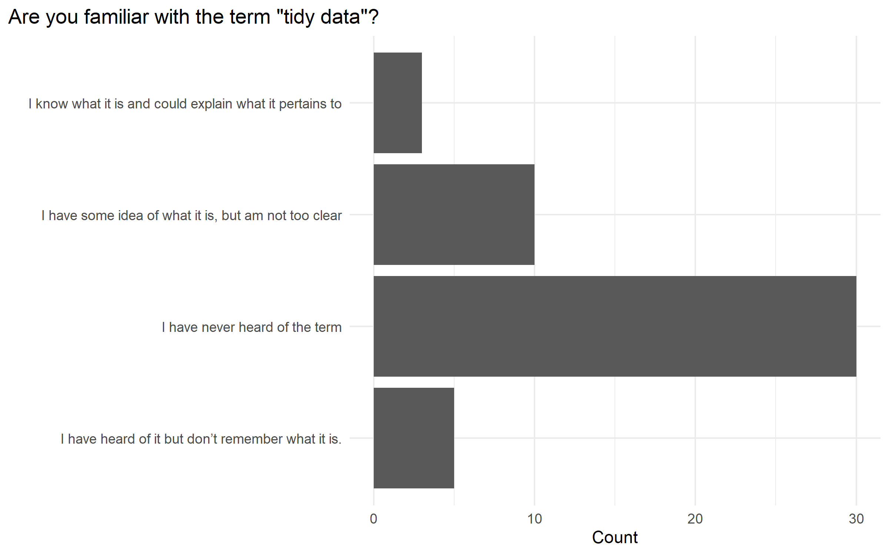

Slide 36
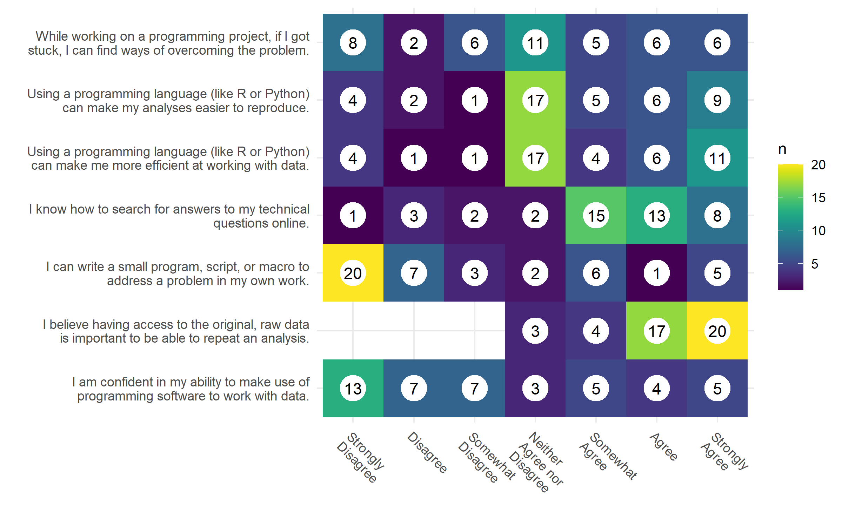
Self-Assessment Survey
People do not program and are indifferent about using a programming language for efficiency and reproducibility.
They do believe having raw, original data is important for reproducibility.

Slide 37
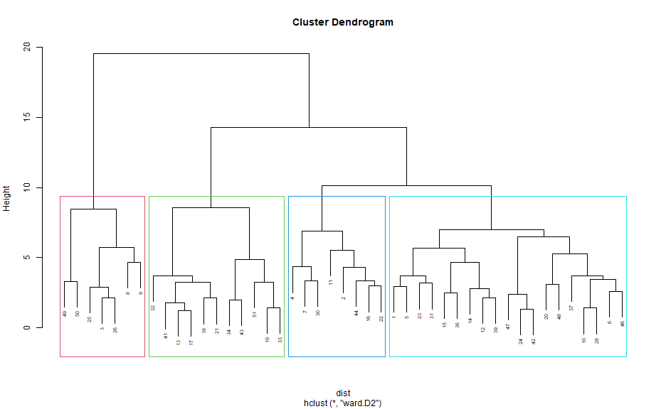
Clustering Dendrogram
Experts
Clinician
Academic
Student

Slide 38
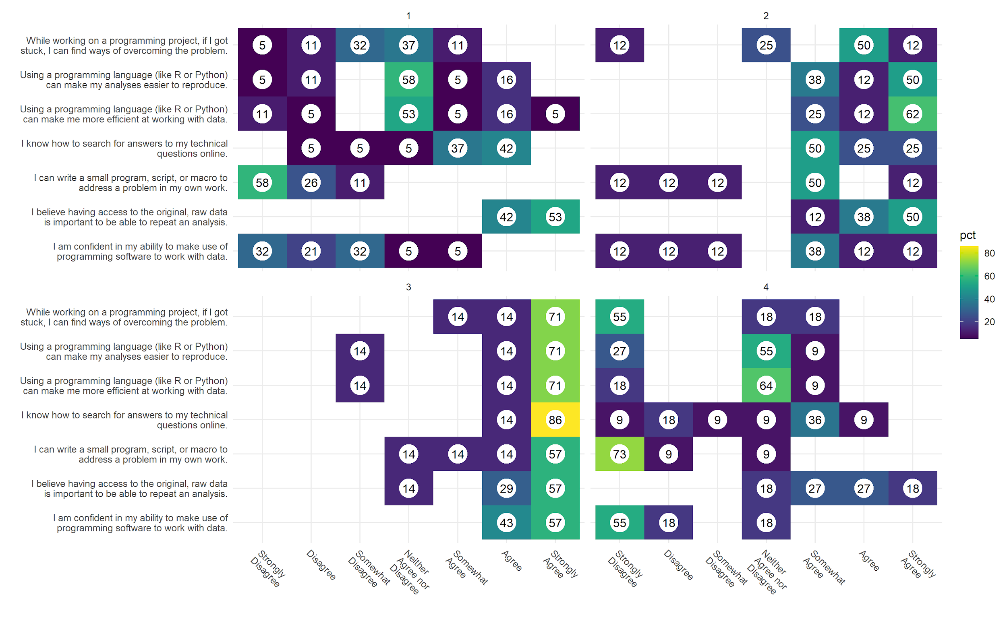
1. Academic
2. Student
3. Expert
4. Clinician

Slide 39
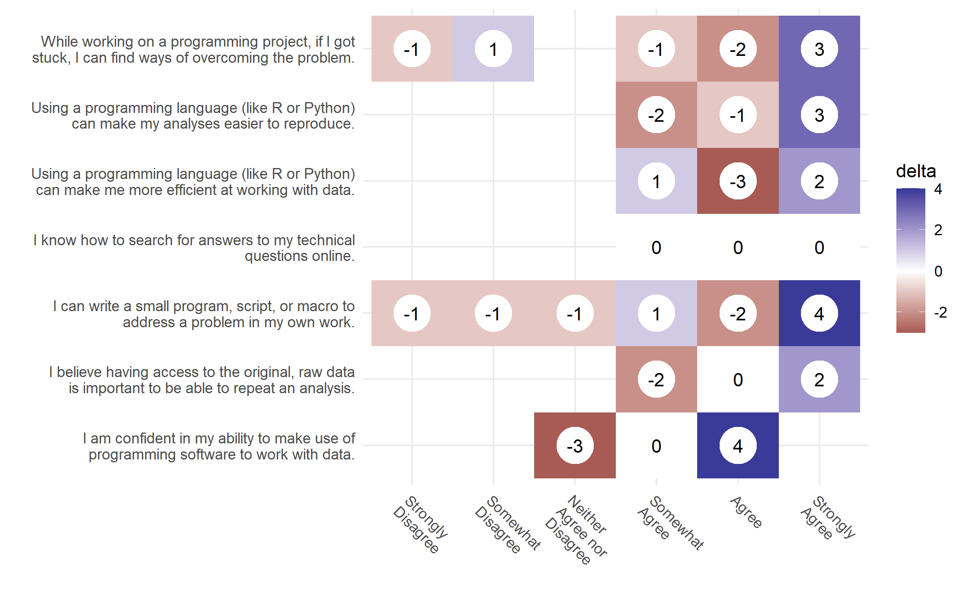
Changes from the pre-workshop and post-workshop responses
Most participants have more confidence in their programming and data abilities

Slide 40
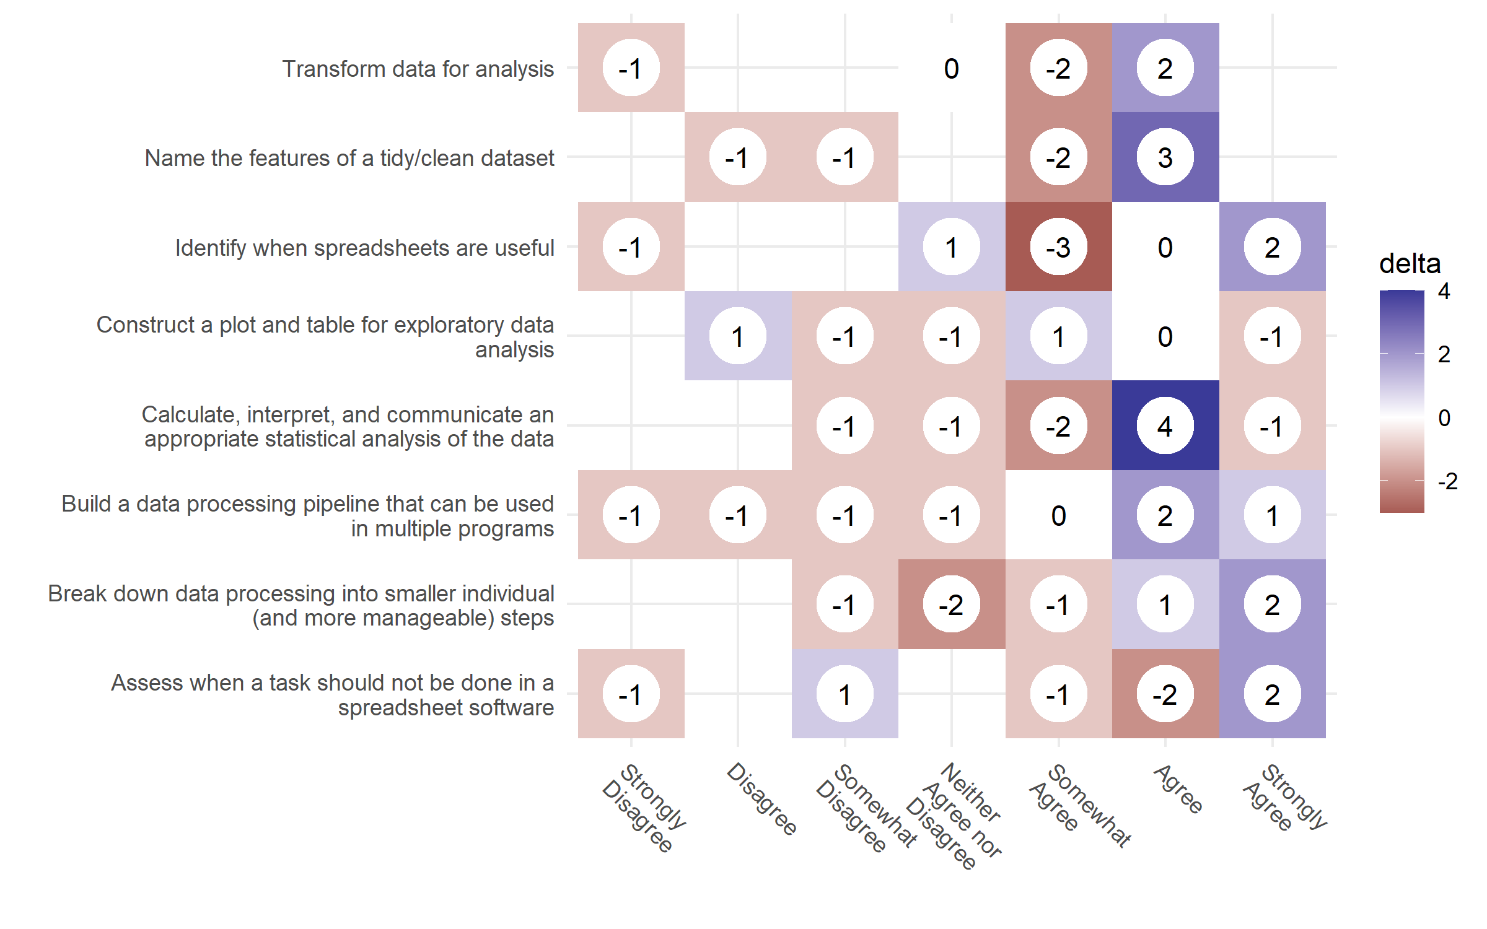
Learning objective pre-post changes
Most participants have more confidence in meeting the learning objectives

Slide 41
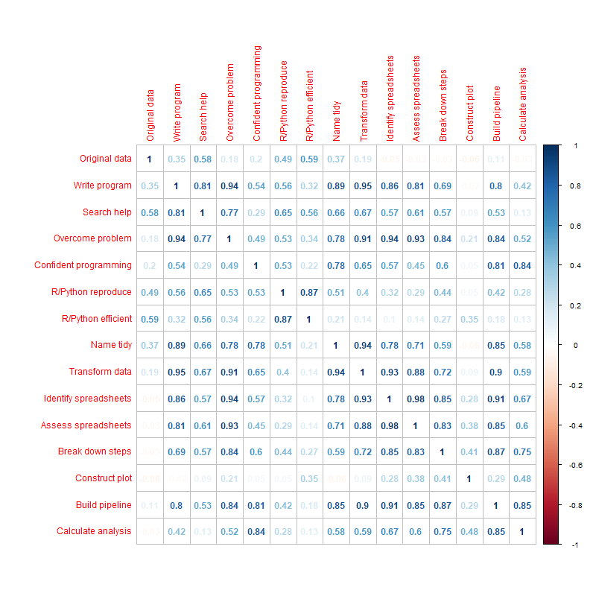
Pre+Post
Correlation

Slide 42
Identifying the Core Concepts: Scientific Computing
Good enough
Data management
Software
Collaboration
Project organization
Keeping track of changes
Manuscripts
Barely sufficient
Availability of software for others to use
Document setup, use, and expectations of code
Version control
Test, mostly at the unit level
Support or maintenance of the software clarified
Best Practices
Write programs for people, not computers
Let the computer to the work
Make incremental changes
Don't repeat yourself (or others)
Plan for mistakes
Optimize software only after it works correctly
Document design and and purpose, not mechanics
Collaborate
(Lee et al., 2021; Wilson et al., 2014, 2017)

Slide 43
Workshop Efficacy
They don’t work…
Spacing instruction over time is better for learning
They do work…
long-format courses are often impractical, but should be used over short-course if practical
Limited instructor capacity
Learner time commitment
Bring people together
Easily adaptable to needs
How to make workshops work:
Streamline content
Teach strategically
Meet learners where they are
Normalize error and demonstrate recovery
Explicitly address motivation and self-efficacy
Build community
(Feldon et al., 2017; Word, 2017)

Slide 44
Existing Data Science Book Topics
R for Data Science
Explore Introduction
Data visualisation
Workflow: basics
Data transformation
Workflow: scripts
Exploratory Data Analysis
Workflow: projects
Wrangle Introduction
Tibbles
Data import
Tidy data
Python for Data Analysis
Preliminaries
Introductory Examples
IPython: An Interactive Computing and Development Environment
NumPy Basics: Arrays and Vectorized Computation
Getting Started with pandas
Data Loading, Storage, and File Formats
Data Wrangling: Clean, Transform, Merge, Reshape
Learning the Pandas Library
Introduction
Installation
Data Structures
Series
Series CRUD
Series Indexing
Series Methods
Series Plotting
Another Series Example
DataFrames
Data Frame Example
Data Frame Methods
Data Frame Statistics
Grouping, Pivoting, and Reshaping
Dealing With Missing Data
Joining Data Frames
Avalanche Analysis and Plotting
Summary
ds4biomed
Introduction
Spreadsheets
R + RStudio
Load Data
Descriptive Calculations
Clean Data (Tidy)
Data Science for JavaScript
Introduction
Basic Features
Callbacks
Objects and Classes
HTML and CSS
Manipulating Pages
Dynamic Pages
Visualizing Data
Promises
Interactive Sites
Managing Data
Pandas for Everyone
Pandas DataFrame Basics
Pandas Data Structures
Introduction to Plotting
Data Assembly
Missing Data
Tidy Data
(Chen, 2017; Gans et al., 2020; Harrison, 2016; McKinney, 2017; Wickham and Garrett, 2017)

Slide 45
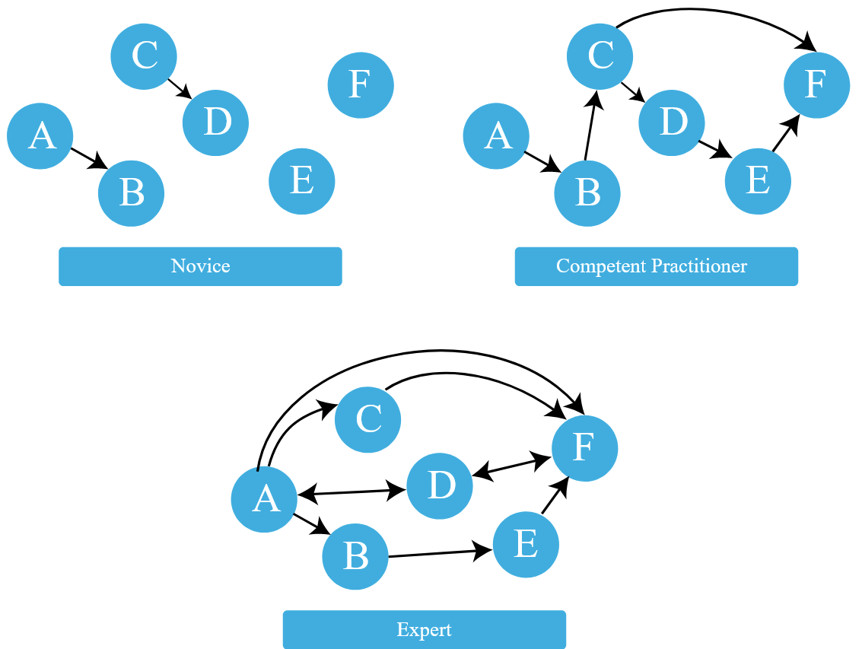
Managing Prior Knowledge
Learner’s prior knowledge can help or hinder learning
Concept maps: graphic of a mental model
(Ambrose et al., 2010; Koch and Wilson, 2016)

Slide 46
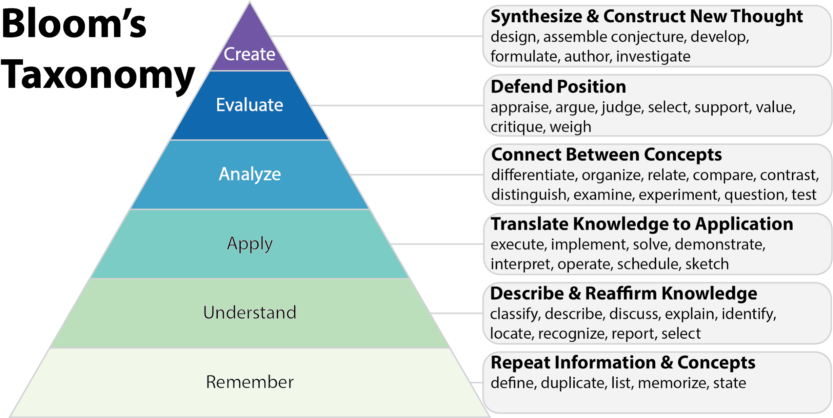
Bloom’s Taxonomy
(Anderson et al., 2001)

Slide 47
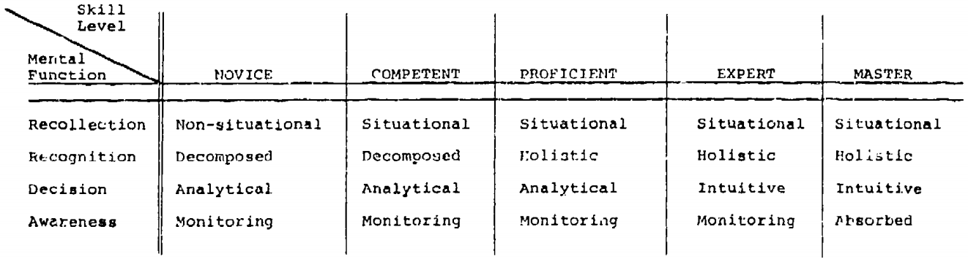
Dreyfus Model of Skill Acqusition
(Dreyfus and Dreyfus, 1980)

Slide 48
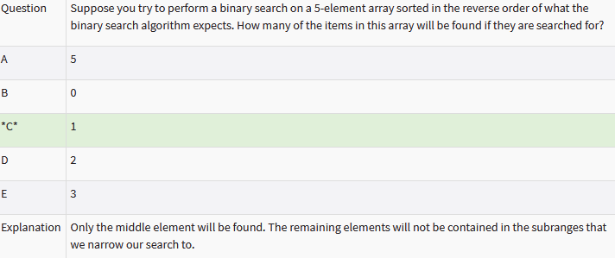
Computer Science Assessment Studies
Novices: never a blank page
Existing code to modify gives structure + more realistic
Canterbury QuestionBank

Slide 49
Auto-graders
Many technical hurdles
Also need to distinguish learner satisfaction with learner outcomes
Might help identify bugs, but may discourage critical thinking
(Wilson, 2019)

Slide 50
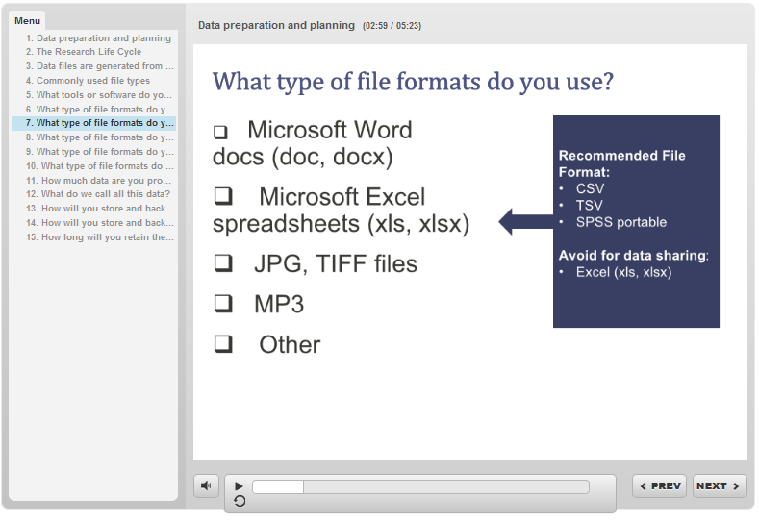
BD2K Open Educational Resources for Biomedical Big Data (R25)
Oregon Health & Science University (OHSU) Educational Materials
OHSU Big Data to Knowledge (BD2K)
Open Educational Resources (OERs) Project
https://dmice.ohsu.edu/bd2k/topics.html

Slide 51
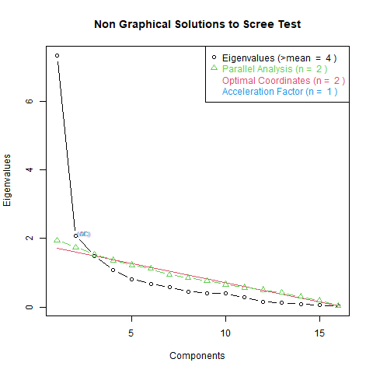
EFA: 2 Optimal Loadings
## Loadings:
## Factor1 Factor2
## Q3.1 0.88
## Q3.3 0.97
## Q3.4 1.04
## Q3.5 0.96
## Q4.3 0.57
## Q5.2 0.68
## Q3.6 0.65
## Q6.1 0.95
## Q6.2 1.05
## Q6.3 0.93
## Q3.7
## Q4.1 0.43
## Q4.2 0.32 0.42
## Q4.4
## Q5.1 -0.37
## Q6.4
## Loadings:
## Factor1 Factor2 Factor3
## Q3.1 0.82
## Q3.3 0.92
## Q3.4 0.90
## Q3.5 0.89
## Q4.3 0.51
## Q5.2 0.67 0.32
## Q6.1 0.83 0.32
## Q6.2 0.90 0.32
## Q6.3 0.84
## Q4.1 0.51
## Q4.4 0.78
## Q6.4 0.33 0.62
## Q3.6 0.46 0.40
## Q3.7
## Q4.2 0.42 0.39 0.41
## Q5.1 -0.43

Slide 52
EFA Results
3 factors with promax rotation.
Each factor coincided with a survey question blocks
Programming
Q3.3: How familiar are you with interactive programming languages like Python or R?
Statistics
Q6.2: If you were given a dateset containing an individual's smoking status (binary variable) and whether or not they have hypertension (binary variable), would you know how to conduct a statistical analysis to see if smoking has an increased relative risk or odds of hypertension? Any type of model will suffice.
Data
Q4.4: Do you know what "long" and "wide" data are?

Slide 53
EFA: Selected questions
6.2: Logistic regression
3.3: Python/R
4.4: Long and wide
I wouldn't know where to start
I could struggle through, but not confident I could do it
I could struggle through by trial and error with a lot of web searches
I could do it quickly with little or no use of external help
I do not know what those are
I have heard of them but have never used them before
I have installed it, but have only done simple examples with them
I have written a small program with them before
I use it to automate certain repetitive tasks
I have small side projects that I program in it
I program in them for work
I have never heard of the term
I have heard of it but don't remember what it is.
I have some idea of what it is, but am not too clear
I know what it is and could explain what it pertains to

Slide 54
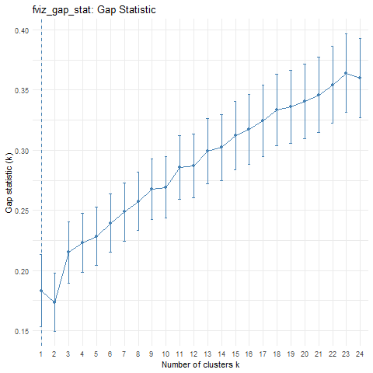
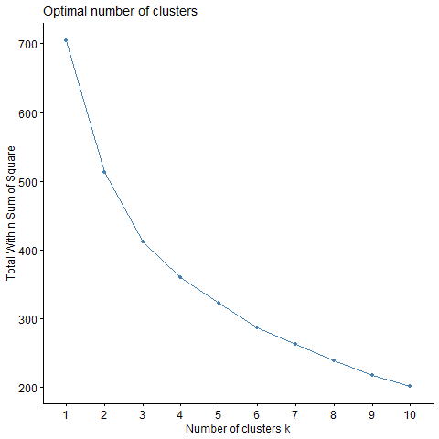
Clustering: 2 Optimal Groups

Slide 55
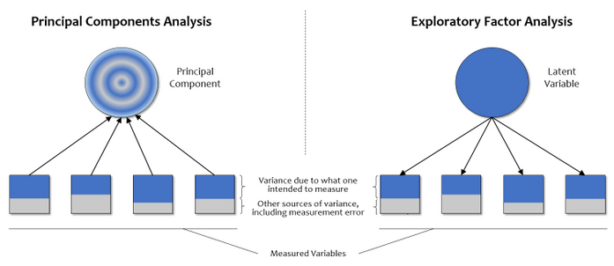
PCA vs EFA
PCA
EFA
dimension reduction
eigenvalue decomposition on full correlation matrix
components are a mix of what the variables intend to measure
latent variable identification
eigenvalue decomposition on reduced correlation matrix (squared multiple correlations)
SMC estimates variance that the underlying factors explain (communality)
(Castro-Schilo, 2017)

Slide 56
EFA vs CFA
EFA
CFA
Explore underlying structure
Our survey has not been explored before in this manner
Verify factor structure
(UCLA: Statistical Consulting Group, 2021)

